Slide 1
Lecture 01 – Introduction to image processing
SIN 392 – Introduction to Digital Image Processing (2023)
Prof. João Fernando Mari
joaofmari.github.io
joaof.mari@ufv.br

Slide 2
Agenda
The Bartlane system
The space program
O electromagnetic spectrum
Image processing in Brazil
An application of image processing
Computer tomography

Slide 3
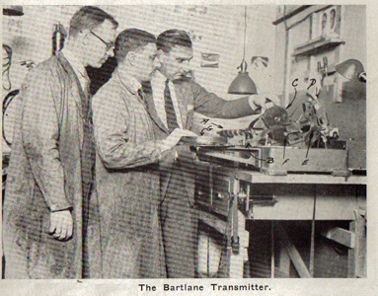
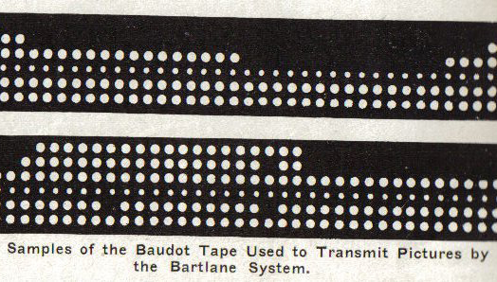
The Bartlane system
One of the first applications of digital images
Used to send digital images through submarine cable between London and New York
It has reduced the time to send a photo across the Atlantic Ocean form over a week to less than three hours
One equipment encoded the images for the cable transmission e latter reconstruct them on the receiving
No image processing occurs
http://www.hffax.de/history/html/bartlane.html

Slide 4
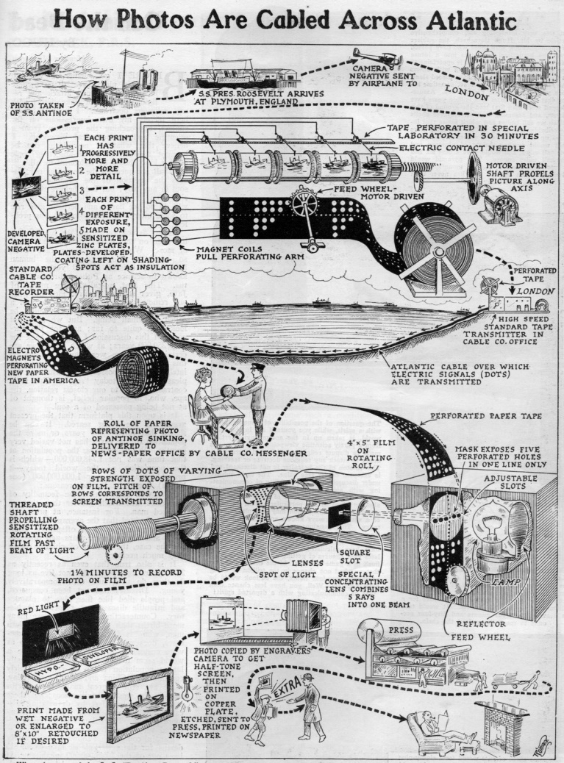
The Bartlane system
Infográfico publicado originalmente na edição de abril de 1926 da revista Science and Invention.

Slide 5

The Bartlane system

Slide 6
The Bartlane system

Slide 7
The Bartlane system

Slide 8
The space program
JPL – Jet Propulsion Lab (Pasadena, California), 1964
Ranger 7
Sonda espacial Ranger enviada para fotografar a Lua
Imagens eram obtidas por câmeras de televisão
Enviadas para a Terra por ondas de rádio
Necessidade de processar as imagens
Melhorar a qualidade das imagens
Obter a maior quantidade de informação possível
Video Film Converter
Desenvolvido para converter os sinais de vídeo analógicos para imagens digitais
Computador NCR 102D
Usado para processar as imagens digitais
Ajuste de contraste
Normalização da iluminação
Remoção da imagens residual proveniente de capturas anteriores
Remoção de ruído de transmissão
Correções geométricas usando marcas reseau.

Slide 9
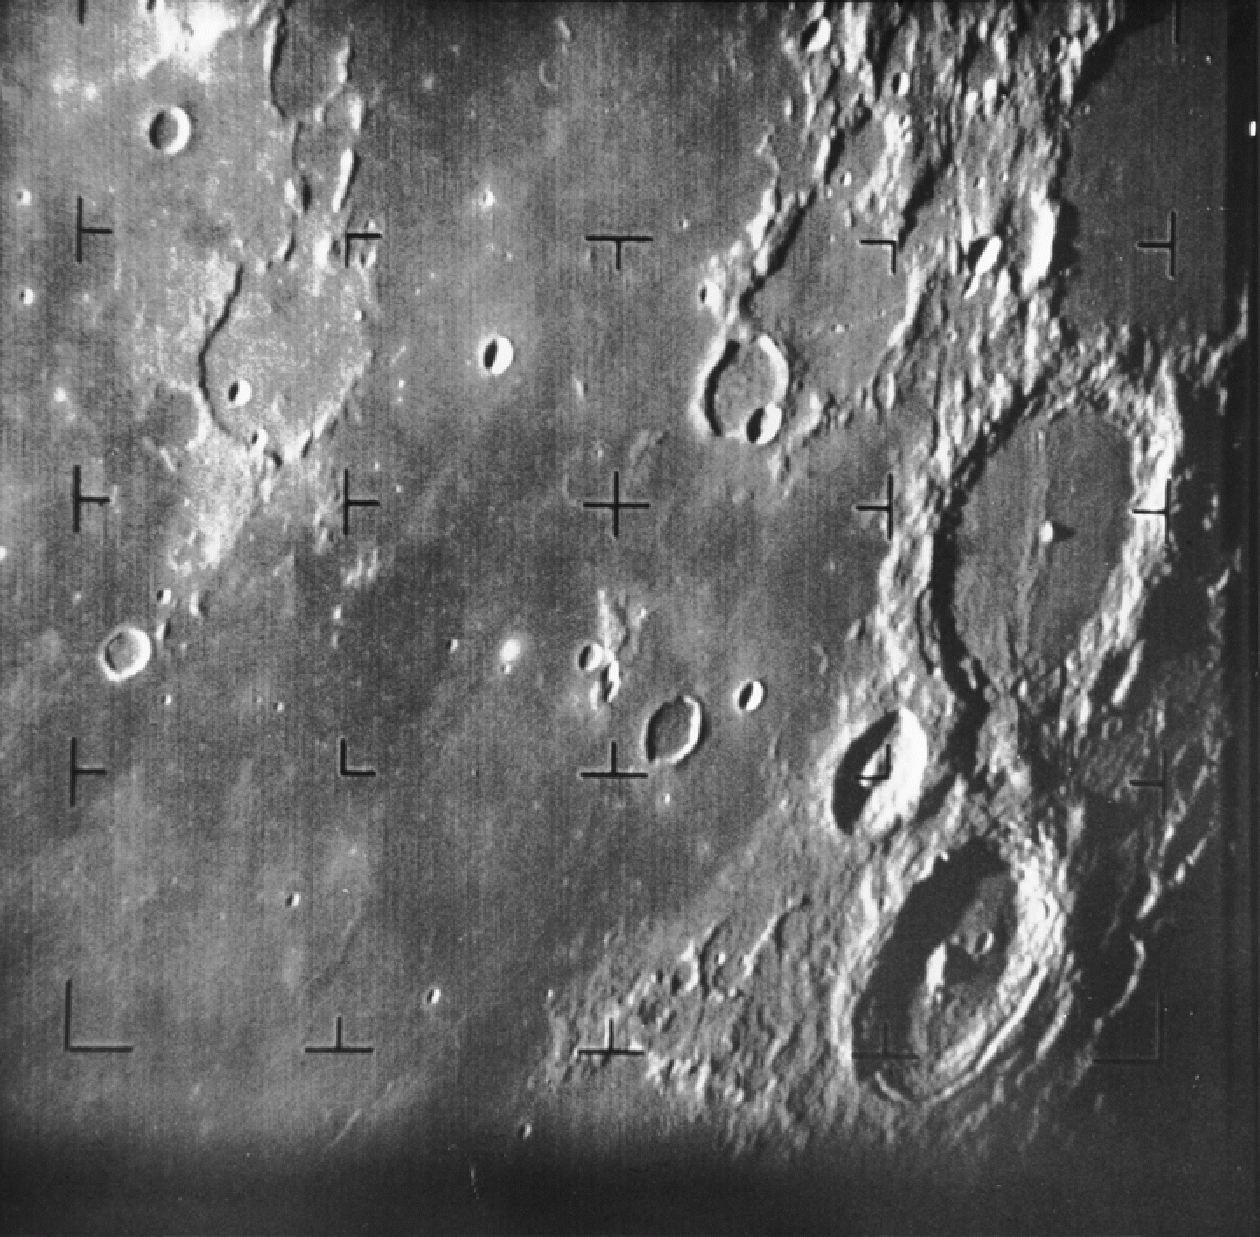
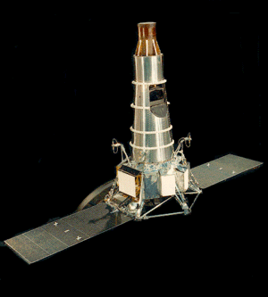
The space program
Fist image of the moon taken by the Ranger 7.
July 31, 1964
About 17 minutes before the impact in the lunar surface.
The Ranger 7 probe.
https://pt.wikipedia.org/wiki/Ranger_7

Slide 10
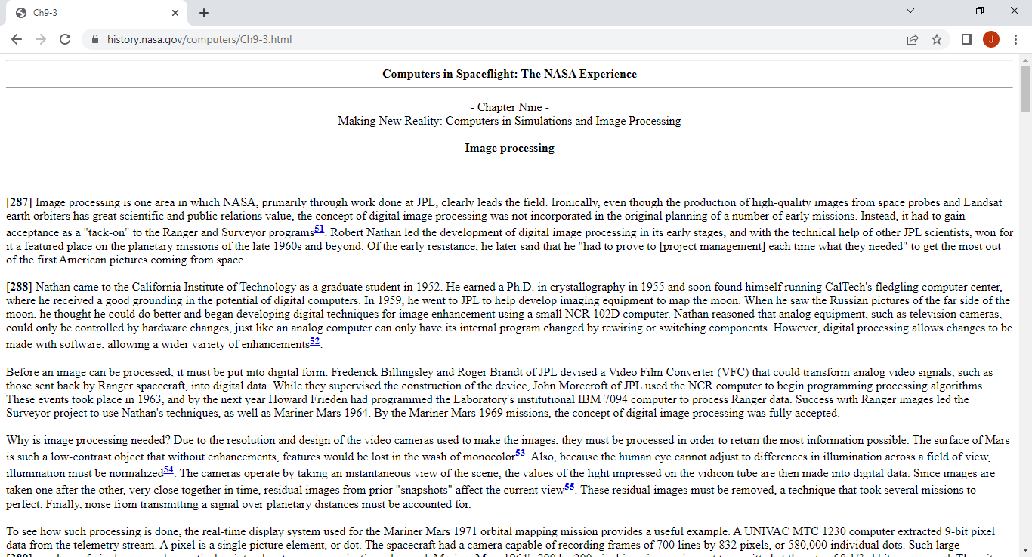
The space program
Computers in Spaceflight: The NASA Experience.
Chapter Nine. Making New Reality: Computers in Simulations and Image Processing.
https://history.nasa.gov/computers/Ch9-3.html

Slide 11
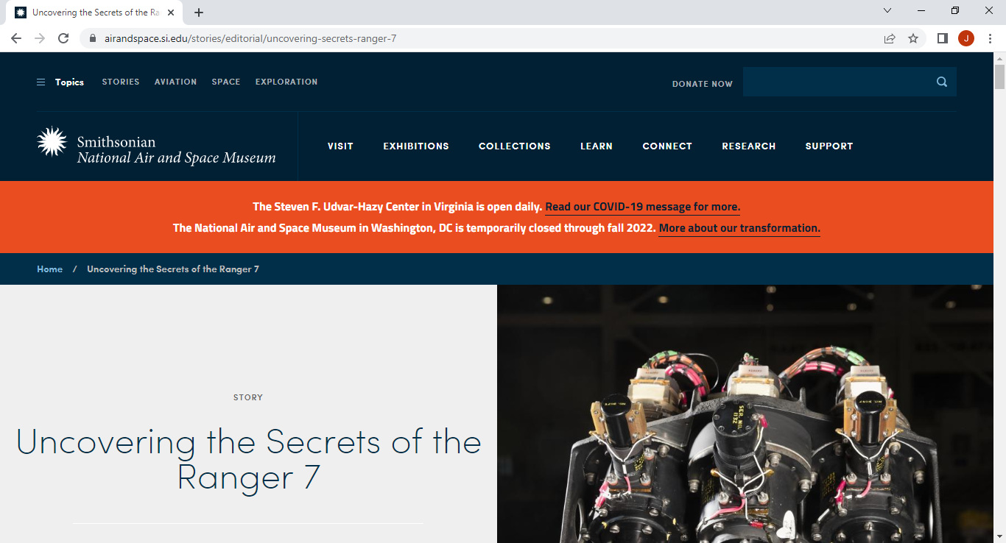
The space program
Matthew Shindell. Uncovering the Secrets of the Ranger 7. July 31, 2018
https://airandspace.si.edu/stories/editorial/uncovering-secrets-ranger-7

Slide 12
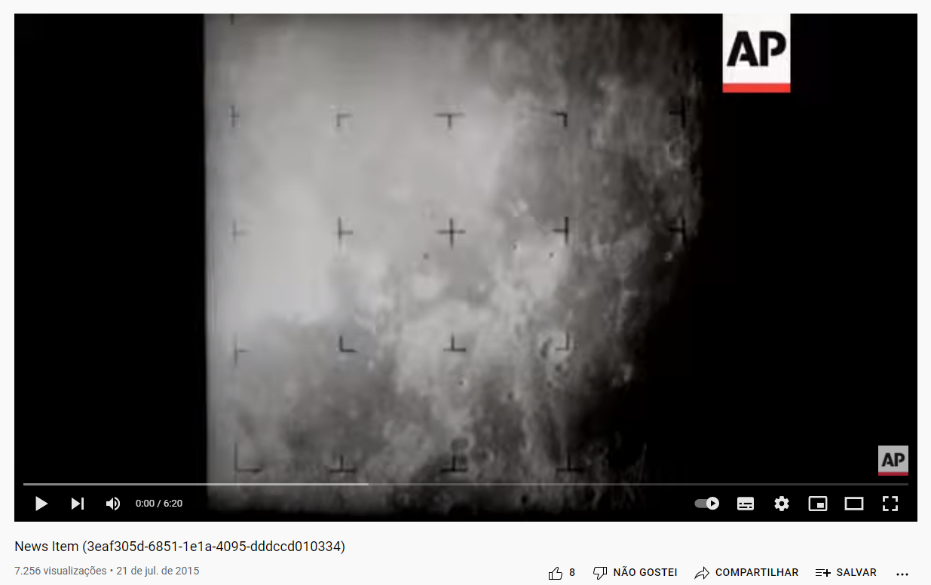
The space program
US: Ranger 7 - 1964
https://www.youtube.com/watch?v=QGJbybcXd0c

Slide 13
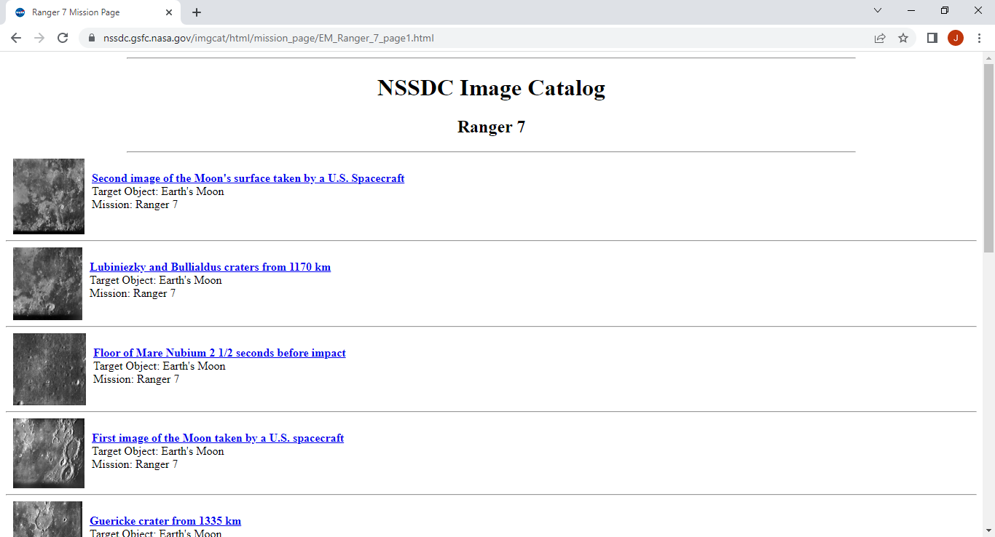
The space program
NSSDC Image Catalog – Ranger 7
https://nssdc.gsfc.nasa.gov/imgcat/html/mission_page/EM_Ranger_7_page1.html

Slide 14
The electromagnetic spectrum
4.3×10¹⁴
4.6×10¹⁴
5.1×10¹⁴
5.7×10¹⁴
6.2×10¹⁴
6.8×10¹⁴
7.3×10¹⁴
7.6×10¹⁴
Hz
VISIBLE
RADIO
MICROWAVE
INFRARED
ULTRAVIOLET
X-RAY
GAMMA RAY
3×10⁹
3×10¹²
4.3×10¹⁴
7.5×10¹⁴
3×10¹⁷
3×10¹⁹
Hz
10³
10²
10¹
10⁰
10⁻¹
10⁻²
10⁻³
10⁻⁴
10⁻⁵
10⁻⁶
10⁻⁷
10⁻⁸
10⁻⁹
10⁻¹⁰
10⁻¹¹
Wavelength, λ, in cm.
3×10⁷
3×10⁸
3×10⁹
3×10¹⁰
3×10¹¹
3×10¹²
3×10¹³
3×10¹⁴
3×10¹⁵
3×10¹⁶
3×10¹⁷
3×10¹⁸
3×10¹⁹
3×10²⁰
3×10²¹
Frequency, f, in Hz.

Slide 15
The electromagnetic spectrum
Remote sensing satellites
Conventional photography
Optical microscopy
Radiography
Visible light telescope
Computer tomography
Radar imaging
Products visual inspection
X-ray telescope
RADIO
MICROWAVE
INFRARED
ULTRAVIOLET
X-RAY
GAMMA RAY
Magnetic resonance imaging
Remote sensing satellites
Gamma ray telescope
Radio telescope
Thermal cams
Lithography
Positron emission tomography (PET)
Fluorescence microscopy
Ultraviolet telescope

Slide 16
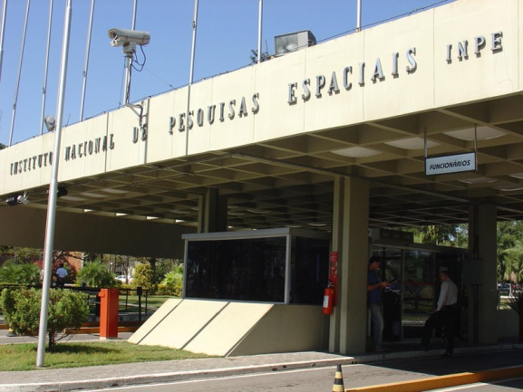
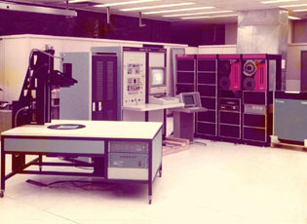
Image processing in Brazil
INPE – National Institute for Space Research
(INPE – Instituto Nacional de Pesquisas Espaciais)
GE IMAGE-100, 1974
Image Processing System
US$ 1.000.000,00
PDP/11-45 with 128 KB memory
Video memory of 512 x 512 pixels
INPE. http://www.inpe.br/noticias/galeria/
INPE: http://www.dpi.inpe.br/DPI/institucional/pessoal/historico

Slide 17
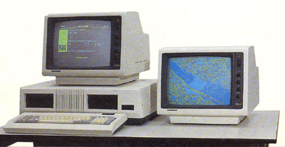
Image processing in Brazil
INPE – National Institute for Space Research
SITIM – Sistema de Tratamento de Imagens, 1986
(in English, Image Treatment System).
PC-286 with 8 MHz and 256 Kb memory
Graphic card locally developed
Images with until 1024 x 1024 pixels and 24 bits per pixel
MS-DOS
INPE: http://www.dpi.inpe.br/DPI/institucional/pessoal/historico

Slide 18
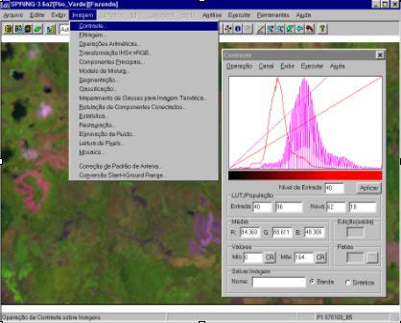
Image processing in Brazil
INPE – National Institute for Space Research
SPRING – Sistema Integrado de Geoprocessamento e Processamento de Imagens, 1991
(in English, Integrated Geoprocessing and Image Processing System)
Graphical user interface
Currently available for download
http://www.dpi.inpe.br/spring/
INPE: http://www.dpi.inpe.br/DPI/institucional/pessoal/historico

Slide 19
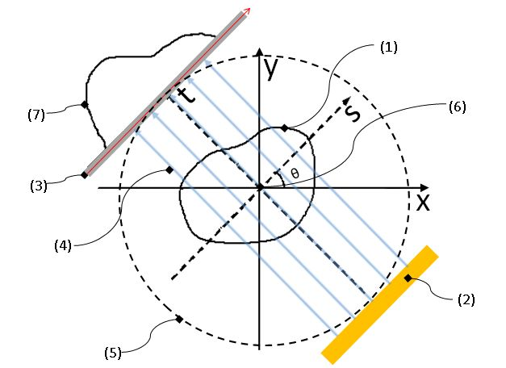
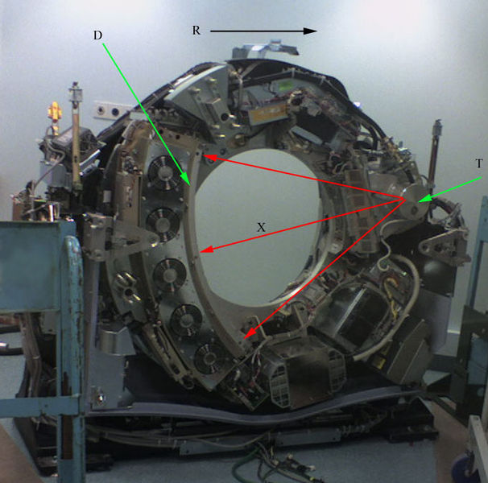
An image processing application
Computer tomography
Allan Cormack and Newbold Hounsfield (1972)
https://pt.wikipedia.org/wiki/Transformada_de_Radon
Objeto radiografado;
Emissor de raios X;
Sensor;
Feixe de raios que atravessa o objeto, sofrendo uma atenuação;
Limites do aparelho;
Origem dos sistemas de referência;
Medida obtida no detector.
https://pt.wikipedia.org/wiki/Tomografia_computadorizada

Slide 20
X-Ray
X-ray emitter 2D
Y
X

Slide 21
X-Ray
Detector
X-ray emitter
Y
Y
X
X
(digital or photographic film)
(digital ou filme fotográfico)

Slide 22
X-Ray
X-ray
Detector
X-ray emitter
(digital or photographic film)

Slide 23
X-Ray
X-ray
X-ray
Detector
X-ray emitter
(digital or photographic film)

Slide 24
X-Ray
X-ray
X-ray
Detector
X-ray emitter
(digital or photographic film)

Slide 25
X-Ray
Detector
X-ray emitter
(digital or photographic film)

Slide 26
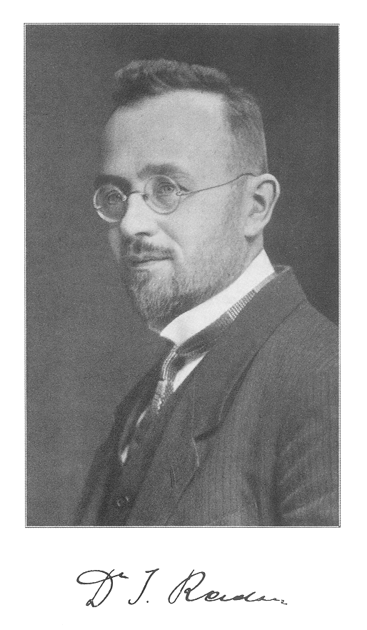
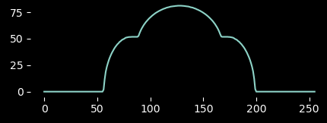
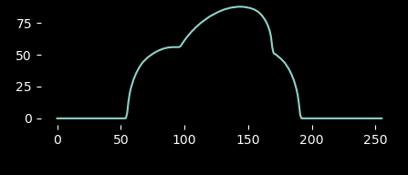
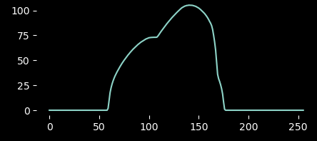

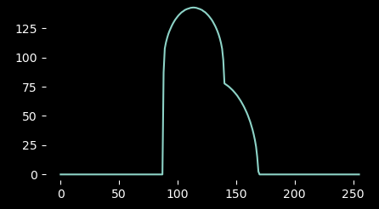
Computer tomography
The Radon transform
Johann Radon (1917)
Reconstrução de funções a partir de projeções
https://pt.wikipedia.org/wiki/Johann_Radon

Slide 27
Computer tomography
Detector (1D)
Emissor de raios-X 1D

Slide 28
Computer tomography

Slide 29
Computer tomography
Sinograma
7
6
5
4
3
2
1
0
 | 0 | 1 | 2 | 3 | 4 | 5 | 6 | 7

Slide 30
Computer tomography
Sinogram
7
6
5
4
3
2
1
0
 | 0 | 1 | 2 | 3 | 4 | 5 | 6 | 7

Slide 31
Computer tomography
Sinogram
7
6
5
4
3
2
1
0
 | 0 | 1 | 2 | 3 | 4 | 5 | 6 | 7

Slide 32
Computer tomography
Sinogram
7
6
5
4
3
2
1
0
 | 0 | 1 | 2 | 3 | 4 | 5 | 6 | 7

Slide 33
Computer tomography
Sinogram
7
6
5
4
3
2
1
0
 | 0 | 1 | 2 | 3 | 4 | 5 | 6 | 7

Slide 34
Computer tomography
Sinogram
7
6
5
4
3
2
1
0
 | 0 | 1 | 2 | 3 | 4 | 5 | 6 | 7

Slide 35
Computer tomography
Sinogram
7
6
5
4
3
2
1
0
 | 0 | 1 | 2 | 3 | 4 | 5 | 6 | 7

Slide 36
Computer tomography
Sinogram
7
6
5
4
3
2
1
0
 | 0 | 1 | 2 | 3 | 4 | 5 | 6 | 7

Slide 37
Computer tomography
Sinogram
7
6
5
4
3
2
1
0
 | 0 | 1 | 2 | 3 | 4 | 5 | 6 | 7

Slide 38
Computer tomography
Sinogram
7
6
5
4
3
2
1
0
 | 0 | 1 | 2 | 3 | 4 | 5 | 6 | 7

Slide 39
Computer tomography
Sinogram
7
6
5
4
3
2
1
0
 | 0 | 1 | 2 | 3 | 4 | 5 | 6 | 7

Slide 40
Computer tomography
Sinogram
7
6
5
4
3
2
1
0
 | 0 | 1 | 2 | 3 | 4 | 5 | 6 | 7

Slide 41
Computer tomography
Sinogram
7
6
5
4
3
2
1
0
 | 0 | 1 | 2 | 3 | 4 | 5 | 6 | 7

Slide 42
Bibliography
GONZALEZ, R.C.; WOODS, R.E. Digital Image Processing. 3rd ed. Pearson, 2007.
MARQUES FILHO, O.; VIEIRA NETO, H. Processamento digital de imagens. Brasport, 1999.
(in Brazilian Portuguese)
Available on the author's website (for personal use only)
http://dainf.ct.utfpr.edu.br/~hvieir/pub.html
scikit-image. Radon transform.
https://scikit-image.org/docs/dev/auto_examples/transform/plot_radon_transform.html

Slide 43
Complementary bibliography
McFarlane, M. D. Digital pictures fifty years ago. in Proceedings of the IEEE, vol. 60, no. 7, pp. 768-770, July 1972, doi: 10.1109/PROC.1972.8775.
https://ieeexplore.ieee.org/document/1450705
Matt NOVAK, M. How To Send a Photo Around the World (in 1926). GIZMODO. July 01, 2018.
https://paleofuture.gizmodo.com/how-to-send-a-photo-around-the-world-in-1926-533206646
NSSDC Image Catalog – Ranger 7
https://nssdc.gsfc.nasa.gov/imgcat/html/mission_page/EM_Ranger_7_page1.html
SHINDELL, M. Uncovering the Secrets of the Ranger 7. July 31, 2018
https://airandspace.si.edu/stories/editorial/uncovering-secrets-ranger-7
US: Ranger 7 - 1964
https://www.youtube.com/watch?v=QGJbybcXd0c

Slide 44
Complementary bibliography
KENT, A.; WILLIAMS, J. G. Computers in Spaceflight: The NASA Experience. Chapter Nine - Making New Reality: Computers in Simulations and Image Processing - Image processing. NASA
https://history.nasa.gov/computers/Ch9-3.html
Billingsley, F. C. Digital Video Processing At Jpl, Proc. SPIE 0003, Electronic Imaging Techniques, (26 September 1965);
https://doi.org/10.1117/12.970964
INPE. A criação da DPI... como tudo começou.
http://www.dpi.inpe.br/DPI/institucional/pessoal/historico
Camara G.; Souza R.C.M.; Freitas, U.M.; Garrido, J. SPRING: Integrating remote sensing and GIS by object-oriented data modelling. Computers & Graphics, 20: (3) 395-403, May-Jun 1996.

Slide 45
THE END
@misc{mari_im_proc_2023,
author = {João Fernando Mari},
title = {Introduction I},
year = {2023},
publisher = {GitHub},
journal = {Introduction to digital image processing - UFV},
howpublished = {\url{https://github.com/joaofmari/SIN392_Introduction-to-digital-image-processing_2023}}
}

